Slide 1
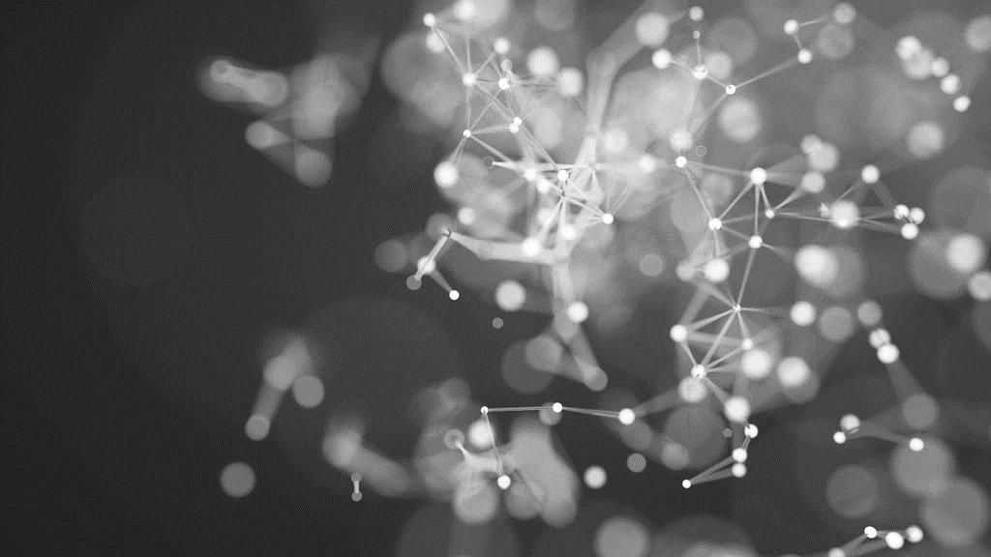
The Power of Artificial Intelligence: A Journey into the World of AI
Md . Mobin Haque
ID: 2102064
10.8.23

Slide 2
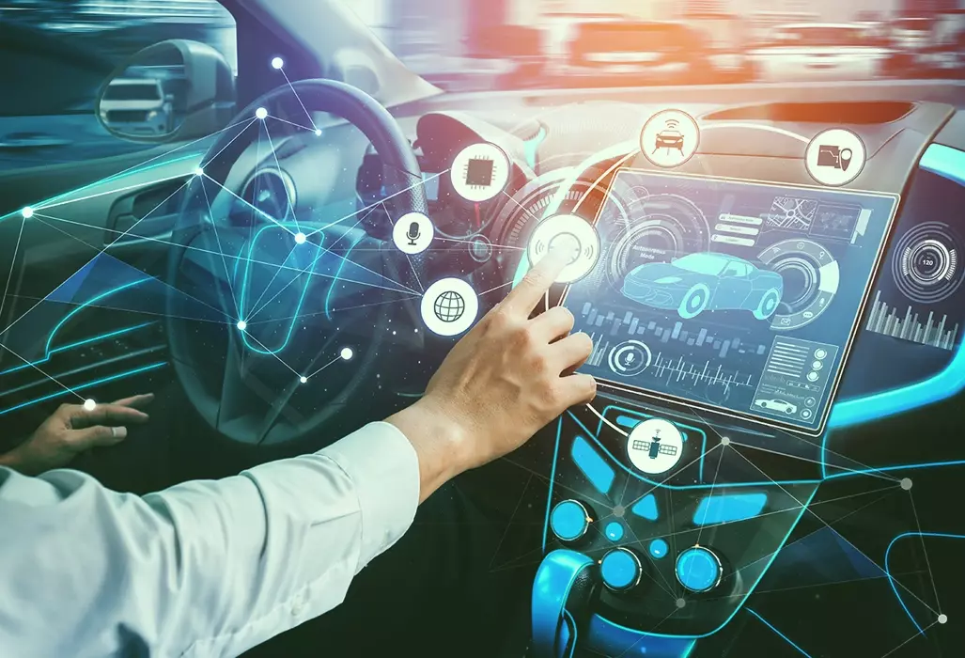
Introduction
Welcome everyone to my presentation on Artificial Intelligence (AI).
AI is a revolutionary technology that is transforming the world we live in, from industries to everyday life.
Today, we'll explore what AI is, its applications, challenges, and the potential it holds for the future.
AI POWER

Slide 3
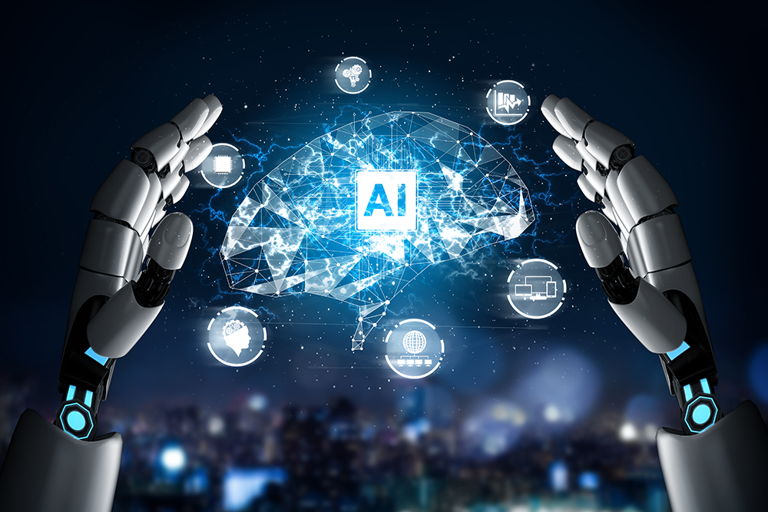
What is AI?
Why do we need AI?
AI is the simulation of human intelligence in machines programmed to think and learn like humans.
It encompasses various techniques such as Machine Learning, Natural Language Processing, Computer Vision, Robotics, and more.
The goal of AI is to enable machines to perform tasks that typically require human intelligence.

Slide 4
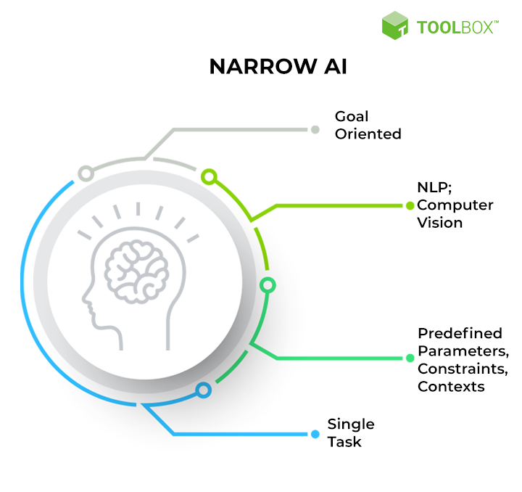
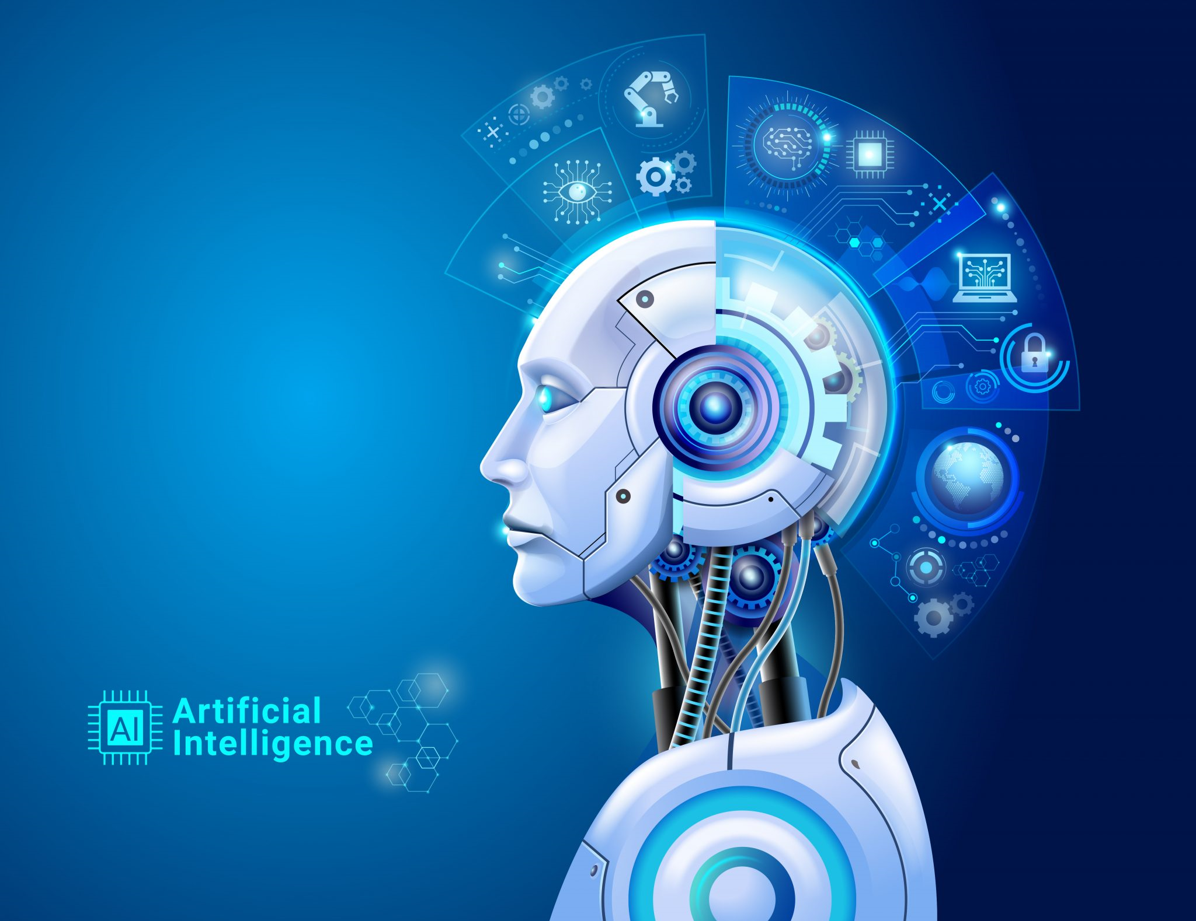
TYPES OF AI
General AI (Strong AI):
Possesses human-like intelligence and the ability to perform any intellectual task.
Currently, this level of AI remains theoretical and futuristic.
Narrow AI (Weak AI):
Designed for specific tasks and limited in scope.
Examples include virtual assistants (e.g., Siri, Alexa), recommendation systems, and chatbots.
Let’s Dive In

Slide 5
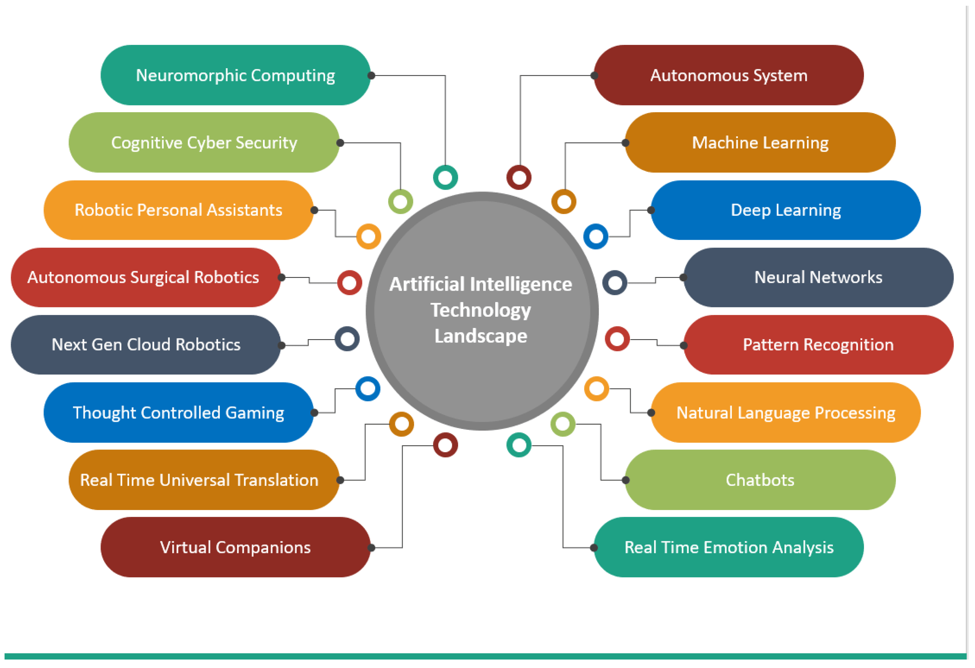
AI APPLICATIONS
AI has already found applications in numerous industries, including:
Healthcare: Diagnosis, drug discovery, personalized treatment plans.
Finance: Fraud detection, algorithmic trading, risk assessment.
Automotive: Self-driving cars, traffic management.
Retail: Customer service, inventory management, personalized marketing.
Manufacturing: Predictive maintenance, quality control, autonomous robots.

Slide 6
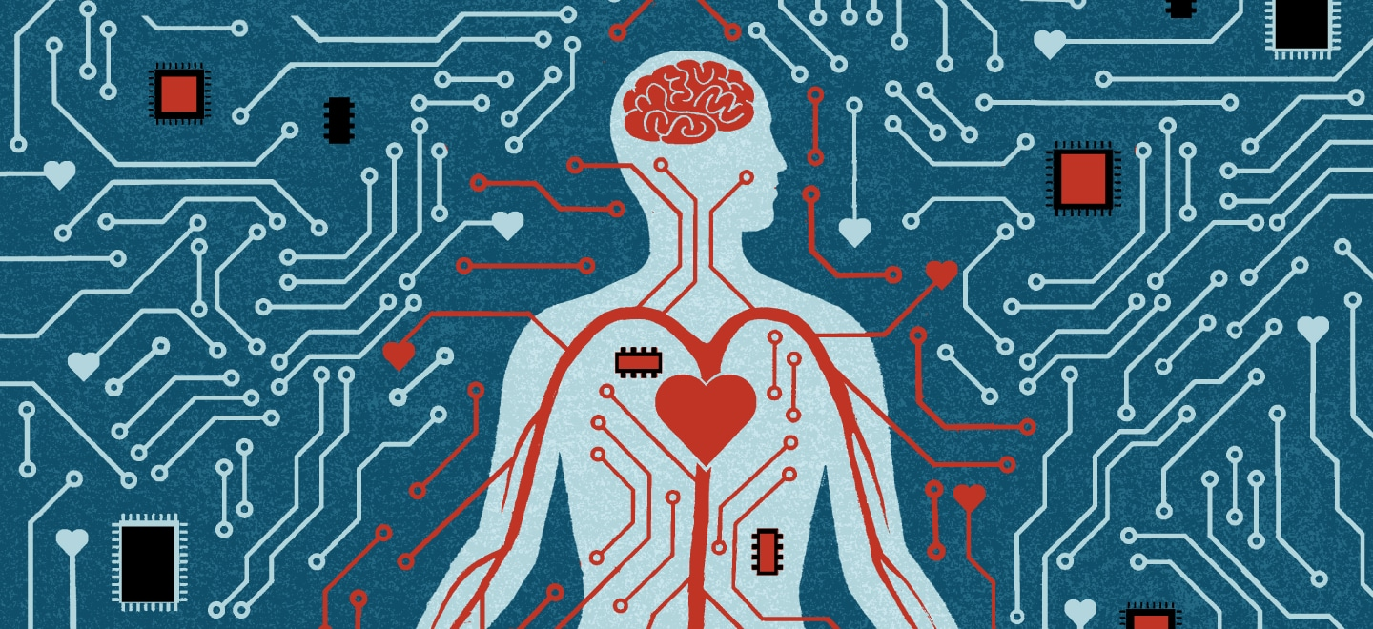
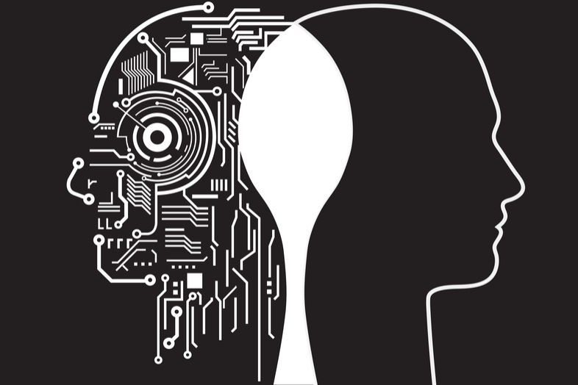
AI Ethics and Challenges
The rapid progress of AI brings ethical considerations:
3. Unemployment due to automation.
4. The possibility of AI outpacing human control (superintelligence).
Bias in AI algorithms and decision-making.
Privacy concerns regarding data collection and usage.

Slide 7
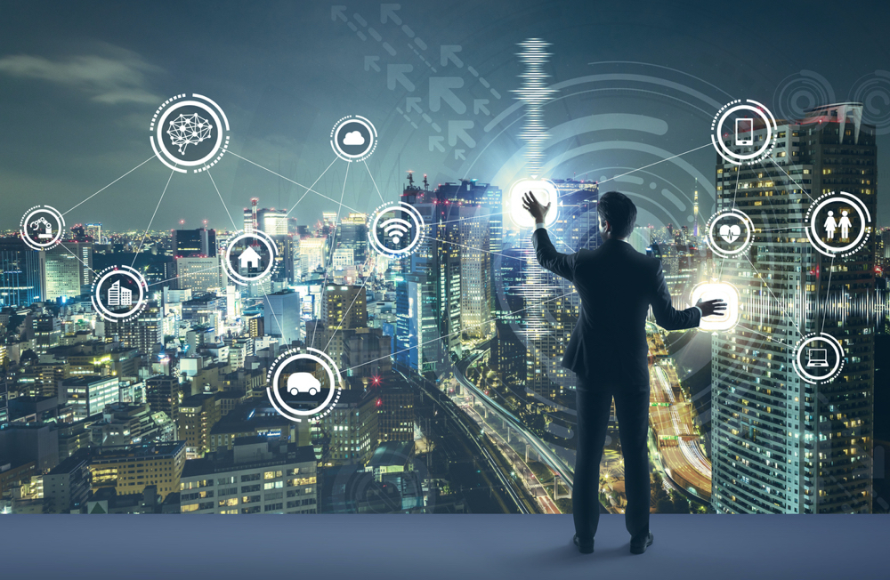
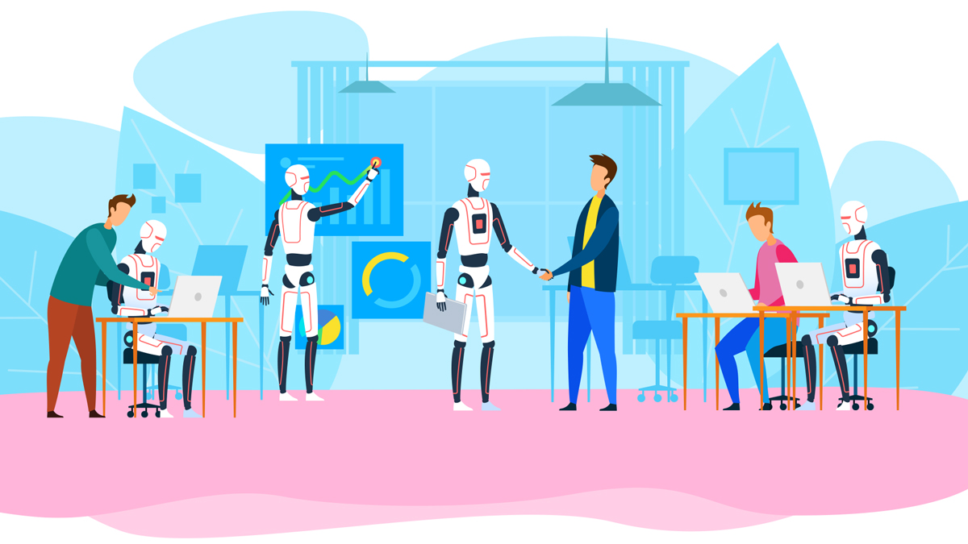
Future of AI
AI's potential is limitless, and its impact on society will continue to grow.
The focus will be on developing responsible AI systems and addressing ethical concerns.
We can expect more widespread integration of AI across industries and daily life.

Slide 8
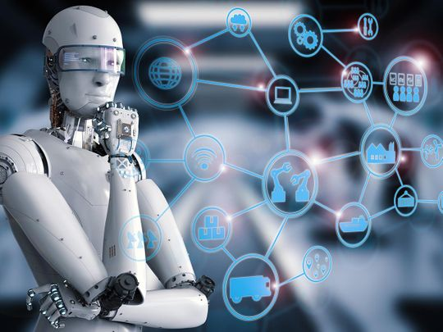
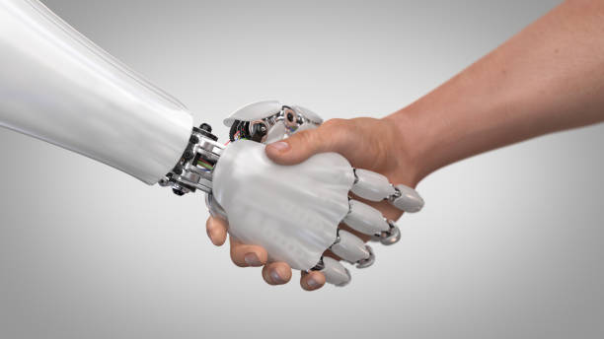
Conclusion
AI is transforming the world in ways we couldn't have imagined.
As we embrace this technology, let's ensure its responsible development and use for the benefit of humanity.
The future of AI is bright, and together, we can shape a world where humans and AI work hand in hand for a better future.

Slide 9




THANK YOU
MD. Mobin Haque
01742650312
mobinhaque112@gmail.com

